Slide 1

Movie Recommendation System using K-means Clustering Big data course, KNTU university Teacher: Dr. Azadi Student: Saber Jabarzadeh
Movie Recommendation System

Slide 2

Abstract
The main focus of this presentation:
Develop a K-means clustering method to recommend movies to a user by watching a movie.

Slide 3

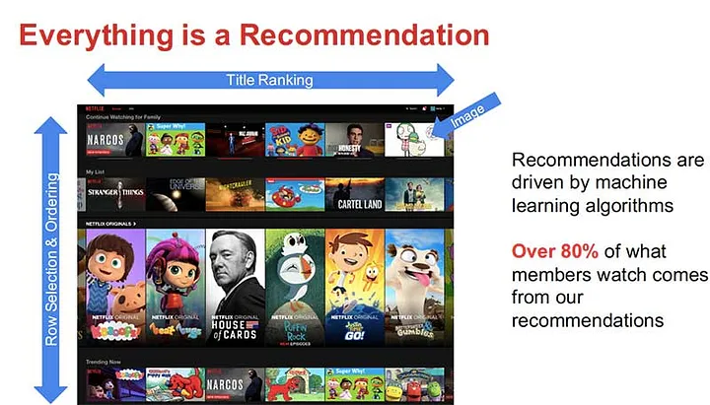
Abstract
Recommender systems predict consumers’ preferences for products and provide proactive suggestions for items they would enjoy.

Slide 4
Abstract
most common types of recommendation models:
Collaborative filtering
content-based
Hybrid recommendation

Slide 5
Abstract
Collaborative filtering generates suggestions based on previous interactions between the user and the item
Majority of content-based recommendations are based on item comparisons.
The majority of hybrid recommender systems are made up of a mix of collaborative filtering and content-based recommender models

Slide 6
Abstract
The Content-Based method was used as the main model in this study, k-means clustering can be applied in certain recommendation scenarios by selecting appropriate features.

Slide 7
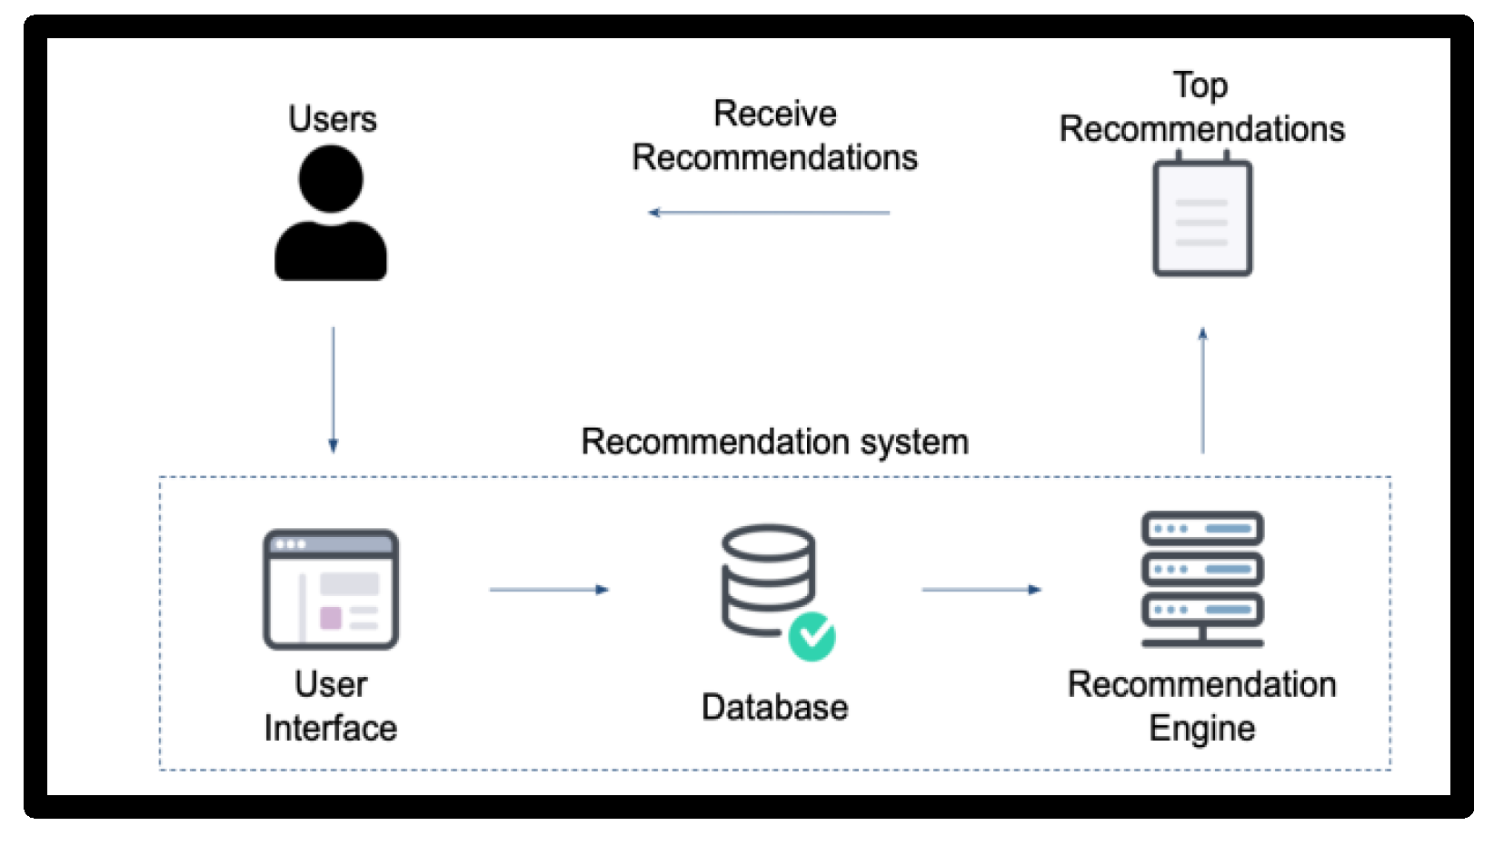
Introduction
A recommendation system is a program that employs various filtering algorithms to deliver suggestions and forecasts to users.

Slide 8
Introduction
The movie business has grown in recent years, with hundreds of films made practically every year; as a result, consumer over-choice has become a problem. As a result, both business and research have embraced movie recommendation systems. Many approaches have been taken in developing recommendation systems.

Slide 9
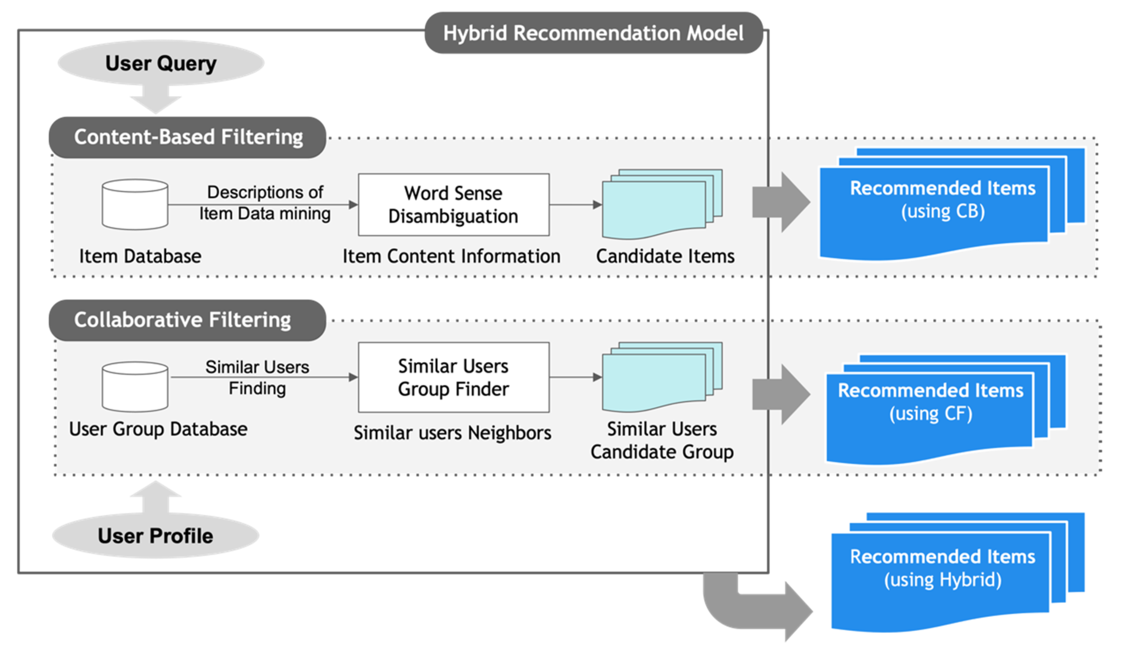
Introduction
What’s our approach?
we offer a collaborative filtering recommendation system based on content. We utilize a keywords feature extraction technique for the content-based approach.

Slide 10
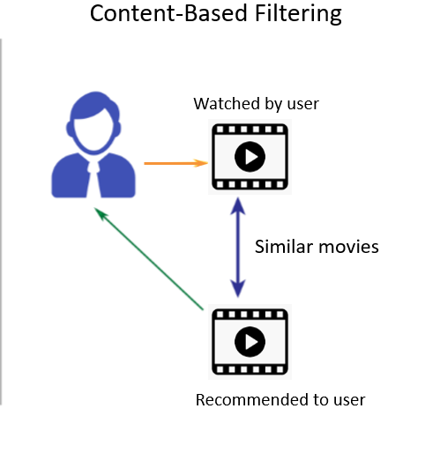
Introduction
General overview of
content-based recommendation systems

Slide 11
Content-Based
A content based recommender works with data that the user provides, either explicitly (rating) or implicitly (clicking on a link). Based on that data, a user profile is generated, which is then used to make suggestions to the user. As the user provides more inputs or takes actions on the recommendations, the engine becomes more and more accurate.

Slide 12
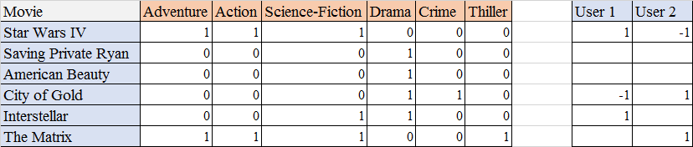
Content-Based (cntd)
This method uses some information that can extract item characteristics as training data.
Some content-based movie recommendation systems employ movie metadata (e.g. movie genre, cast, director of the movie) as input.

Slide 13
Content-Based (cntd)
Text documents are the other most common information source for content-based recommendation systems and we can get help from NLP to process content.

Slide 14
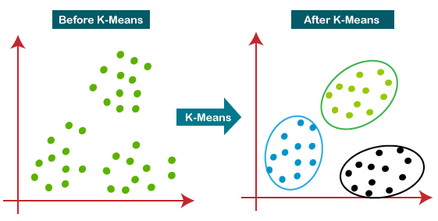
K-means
K-means clustering is a popular machine learning algorithm used for grouping similar data points into clusters. While it is not typically used directly for movie recommendation systems, it can be applied as a part of the recommendation process.

Slide 15
K-means (cntd)
In movie recommendation systems, clustering techniques like k-means can be employed to identify groups movies with similar characteristics. This is often done by analyzing features such as movie genres, actors, directors, user ratings, or other relevant attributes.
In the context of movie recommendation, content-based k-means clustering can be used to group movies together based on their attributes or content characteristics. These attributes could include genres, actors, directors, plot keywords, or any other relevant information that describes the movie.

Slide 16
K-means (cntd)
Here's a general outline of how content-based k-means clustering can be applied in movie recommendation:
Data collection: Gather data on movies, including attributes such as genres, actors, directors, plot keywords, and any other relevant information.
Feature extraction: Represent each movie as a feature vector that captures its content attributes. For example, you could create a binary vector where each dimension represents the presence or absence of a specific genre, actor, or director in the movie.
Feature normalization: Normalize the feature vectors to ensure that different attributes are on a similar scale. This step is important for accurate clustering.

Slide 17
K-means (cntd)
4. Clustering: Apply the k-means algorithm to cluster the movies based on their feature vectors. The algorithm will group similar movies together into clusters, where similarity is determined by the content attributes.
5. Cluster analysis: Analyze the resulting clusters to understand the relationships between movies based on their content. This can help identify groups of movies with similar characteristics.
5. Recommendation generation: Once the clusters are formed, you can recommend movies to users based on their preferences. For example, if a user expresses a preference for a specific movie, you can recommend other movies from the same cluster as similar content-wise.

Slide 18
K-means (cntd)
Content-based k-means clustering can provide recommendations based on the similarity of movie content attributes. However, it is important to note that this approach does not consider user preferences or feedback. Therefore, it may not capture more nuanced or personalized recommendations that collaborative filtering methods can provide.
To enhance the recommendation system, a hybrid approach can be employed by combining content-based filtering with collaborative filtering techniques. This allows for a more comprehensive recommendation process that takes into account both content attributes and user behavior.

Slide 19
Methodology

Slide 20

Data
We use set of MovieLens datasets:
Dataset that retrieved from the MovieLens website, which has 27,753,444 ratings and 1,108,997 tag applications scattered across 58098 movies and was gathered between January 9,1995 and September 26, 2018, and was made by 283,228 people.
We use 3384 record of movies for our recommender system

Slide 21
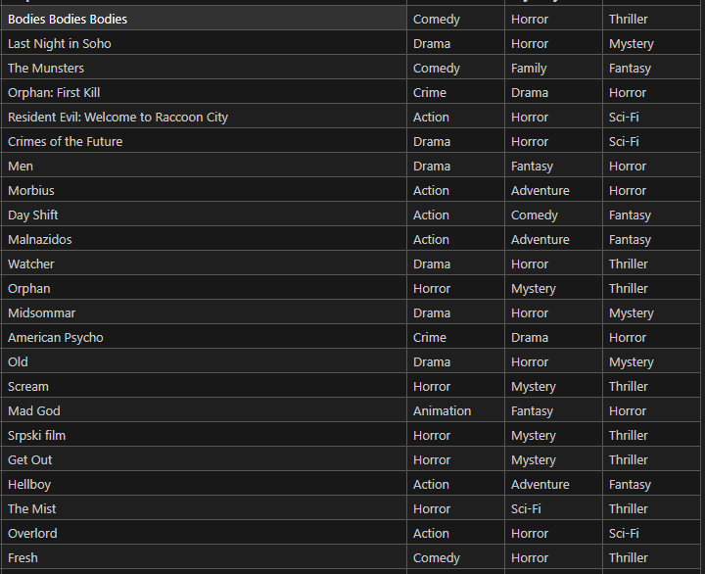
Data

Slide 22
Models and Feature Extraction
We use only movies dataset from MovieLens dataset, we select below features as clustering features:
Movie Name
Primary Genre
Secondary Genre
Tertiary Genre

Slide 23
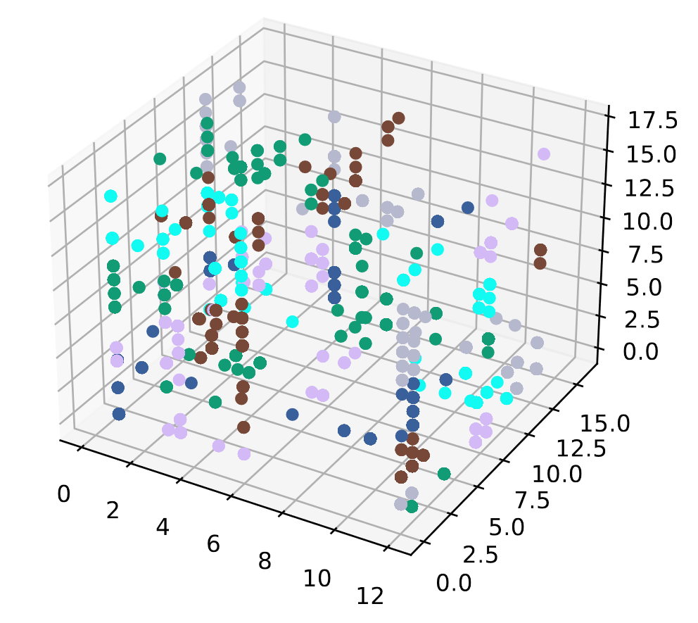
Results (CB)
In this section, we will go through the outcomes of our
recommendation system.
The blow plot, shows the clustering in 50 clusters.

Slide 24
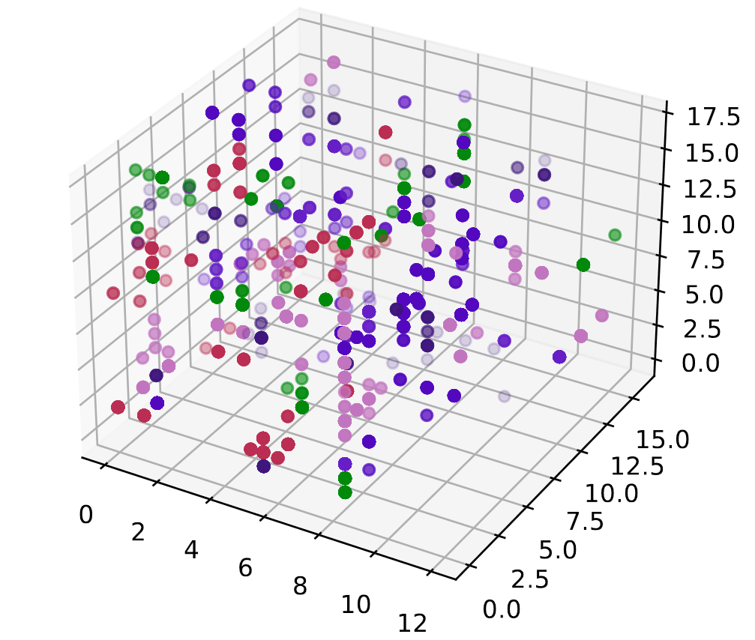
Results (CB)
If we change cluster numbers to 75, the blow cluster would be our result.

Slide 25
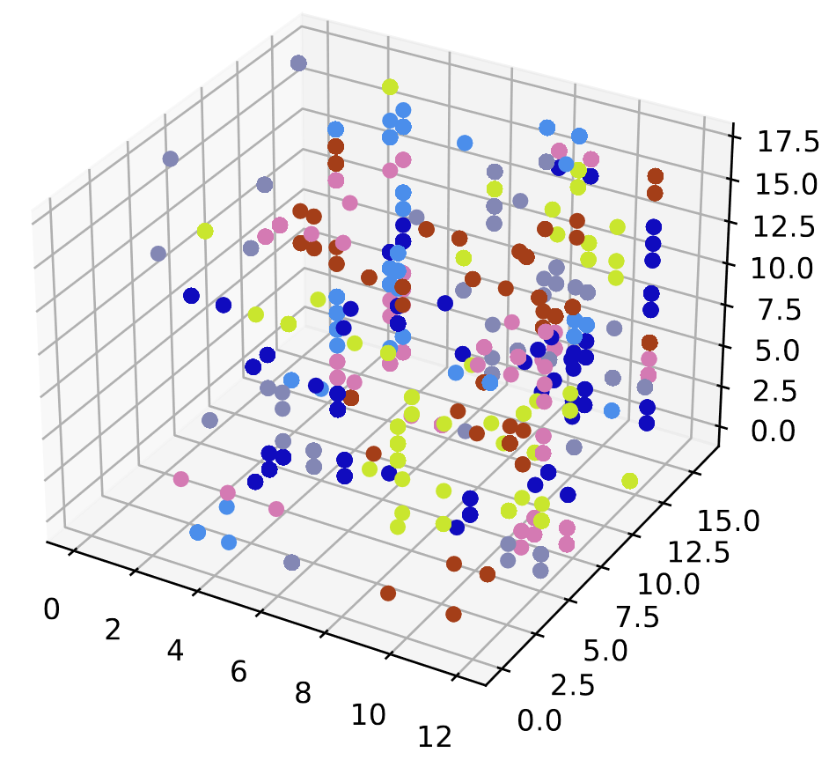
Results (CB)
And for 100 clusters:

Slide 26
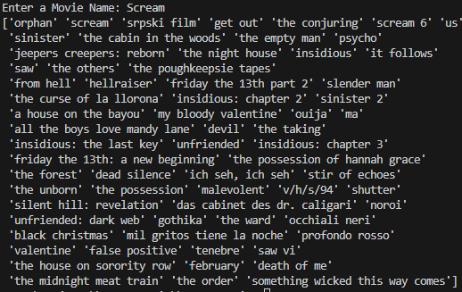
Results (CB)
In example, with we want similar movies to “Scream” movie, we receive this result:

Slide 27
CONCLUSION (cntd)
While k-means clustering may have limitations in certain aspects of movie recommendation systems, it can still offer some benefits when used appropriately. Here are a few advantages of utilizing k-means for movie recommendation:
Interpretability: K-means clustering produces clusters of movies based on their content attributes. These clusters can be interpreted to gain insights into the underlying characteristics or themes within the movie dataset. By examining the movies within each cluster, you can identify commonalities and understand the relationships between different genres, actors, directors, or other content features. This interpretability can be valuable for understanding the movie landscape and making informed recommendations.

Slide 28
CONCLUSION (cntd)
Diversity of recommendations: K-means clustering can help ensure diversity in movie recommendations by grouping similar movies together. When generating recommendations, you can select movies from different clusters to provide a broader range of options to users. This approach promotes serendipity and prevents the system from recommending only popular or mainstream movies. By leveraging the clusters formed by k-means, you can encourage exploration and introduce users to movies they might not have otherwise considered.

Slide 29
CONCLUSION (cntd)
Scalability for content-based systems: Content-based recommendation systems that rely on movie attributes can benefit from the scalability of k-means clustering. It can handle large datasets efficiently and enable faster processing and clustering of movies based on their content features. This scalability makes it suitable for applications with substantial movie catalogs and high-dimensional content attributes.

Slide 30
CONCLUSION (cntd)
Hybrid approaches: While k-means may not be the sole technique for generating movie recommendations, it can be used as part of a hybrid approach. By combining k-means clustering with other recommendation methods like collaborative filtering or matrix factorization, you can leverage the strengths of different algorithms. For example, k-means clustering can be used to form initial clusters of movies, and then collaborative filtering can be applied within those clusters to make personalized recommendations based on user behavior.

Slide 31
CONCLUSION (cntd)
Incremental updates: K-means clustering supports incremental updates, allowing for efficient adaptation to changing data or the addition of new movies. When new movies are added to the system or new user preferences are collected, the clustering model can be updated incrementally without needing to reprocess the entire dataset. This feature enables real-time or near real-time recommendation systems that can adapt to evolving user preferences and movie content.

Slide 32
CONCLUSION (cntd)
While k-means clustering can be applied in recommender systems, it does have some disadvantages when used as the primary technique for generating recommendations. Here are a few drawbacks of using k-means for recommender systems:
Cold start problem: K-means clustering requires a pre-existing dataset of user preferences or movie attributes. This poses a challenge when dealing with new users or movies that have limited or no data available. K-means may struggle to provide accurate recommendations in such "cold start" scenarios.

Slide 33
CONCLUSION (cntd)
Scalability: K-means clustering can become computationally expensive and time-consuming when dealing with large datasets, especially as the number of dimensions or features increases.
Determining the number of clusters (k): Choosing the appropriate number of clusters in k-means clustering is often a subjective decision. Selecting an inappropriate value for k can result in suboptimal clustering, leading to less accurate recommendations. There is no definitive rule for determining the ideal number of clusters, and it often requires experimentation or domain knowledge.

Slide 34
CONCLUSION (cntd)
Sensitivity to initial cluster centroids: K-means clustering is sensitive to the initial selection of cluster centroids. Different initializations can lead to different outcomes, which can be suboptimal. To mitigate this, multiple runs of the algorithm with different initializations are often performed, and the best clustering result is selected. However, this adds to the computational cost.
Limited in capturing complex relationships: K-means clustering assumes that clusters are convex and isotropic, meaning they have similar variances and densities. However, in recommender systems, user preferences and movie similarities can exhibit more complex relationships. K-means may struggle to capture non-linear or complex patterns, leading to less accurate recommendations.

Slide 35
Thanks for attention ☺

